Slide 1
WEB APLICATION DEVELOPMENT TRAINING
LECTURE SLIDES - JAVASCRIPT

Slide 2
Array
JavaScript arrays are used to store multiple values in a single variable.
var cars = ["Saab", "Volvo", "BMW"];

Slide 3
What is an Array?
An array is a special variable, which can hold more than one value at a time.
If you have a list of items (a list of car names, for example), storing the cars in single variables could look like this:

Slide 4
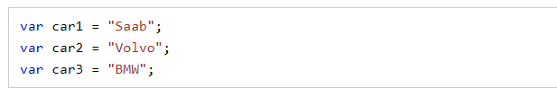
What is an Array?
However, what if you want to loop through the cars and find a specific one? And what if you had not 3 cars, but 300?
The solution is an array!
An array can hold many values under a single name, and you can access the values by referring to an index number.

Slide 5
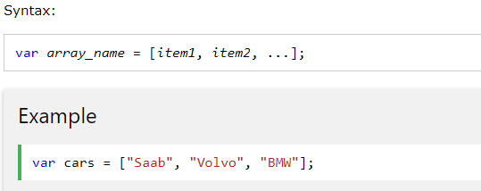
Creating an Array
Using an array literal is the easiest way to create a JavaScript Array.
Notes:
The two examples above do exactly the same. There is no need to use new Array().
For simplicity, readability and execution speed, use the first one (the array literal method).

Slide 6
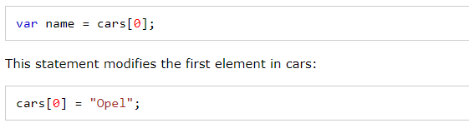

Access the Elements of an Array
You refer to an array element by referring to the index number.
This statement accesses the value of the first element in cars:

Slide 7
Loop
In any loop statement, note the following are the important points to consider: Every loop must have:
  The starting point
  Condition to repeat block of code
  The incrementing of starting point / step

Slide 8
JS Loops
Used if you want to run the same code over and over again
for (statement 1; statement 2; statement 3) {
code block to be executed
}
Statement 1 is executed before the loop (the code block) starts.
Statement 2 defines the condition for running the loop (the code block).
Statement 3 is executed each time after the loop (the code block) has been executed.

Slide 9
JS Loops
You can initiate many values in statement 1 (separated by comma)
for (i = 0, len = cars.length, text = ""; i < len; i++) {
text += cars[i] + "<br>";
}

Slide 10
Jumping out of a loop
The break statement can be used to jump out of a loop and continue to execute the codes after the loop, just as used in the switch statement.
The continue statement breaks one iteration (in the loop), if a specified condition occurs, and continues with the next iteration in the loop
for (i = 0; i < 10; i++) {
if (i === 3) { continue; }
text += "The number is " + i + "<br>";
}

Slide 11
While Loop
The while loop loops through a block of code as long as a specified condition is true.
while (condition) {
code block to be executed
}
If you forget to increase the variable used in the condition, the loop will never end. This will crash your browser. Adjust the code below and make it alert text
while (i < 10) {
text += "The number is " + i;
i++;
}

Slide 12
The Do/While Loop
The do/while loop is a variant of the while loop.
The loop will execute the code block once even if the condition is false, before checking if the condition is true, then it will repeat the loop as long as the condition is true
do {
code block to be executed
}
while (condition);

Slide 13
Arrays
Array is used to store multiple values in a single variable
It stores a collection of elements of the same type
Arrays can be created with the new keyword. Example: new Array("First","Second","Third");
You can create array by simply assigning values as follows −var fruits = [ "apple", "mango" ]; (recommended method of array creation)
To access the values in the array, you will reference using the index, index starts from 0

Slide 14
The DOM and HTML Element Selector
You will observe the plural “s” at the end of getElementsByTagName and getElementsByClassName. This is because there are many element results that will be fetched – Remember many tags can belong to the same class, the same for Tag (there can be several <p > tags on the page
var x = document. getElementsByTagName(“p”) will return many p’s stored in x as x[0], x[1], x[2] etc
You can then apply the formating to each of them like x[0].style.color=“red”;

Slide 15
Array Methods
Javascript array join() method joins all the elements of an array into a string. The syntax is: array.join(separator);
separator − Specifies a string to separate each element of the array. If omitted, the array elements are separated with a comma.
  var myarray = ["Jamiu","Fisayo","Tessy","Ola"];
  var arraystr = myarray.join("-") ;
  alert(arraystr);

Slide 16
Array Methods
toString() method returns a string representing the specified array and its elements
Syntax is array.toString();
Array.sort()
Javascript array pop() method removes the last element from an array and returns that element.
Syntax is : array.pop();
Javascript array push() method appends the given element(s) in the last of the array and returns the length of the new array. Syntax is array.push(element1, ..., elementN);
array.sort(); arranges the elements of the array

Slide 17
Array Methods
The concat() method is used to join two or more arrays.
This method does not change the existing arrays, but returns a new array, containing the values of the joined arrays
Syntax is: array1.concat(array2, array3, ..., arrayX) where array2,array3 are the arrays to be joined. Also available in string method
endsWith() checks if a string ends with the specified string.
This method returns true if the string ends with the characters, and false if not.
It is case sensitive

Slide 18
String Methods
str.replace(“search str", “replacement value");
string.substr(start, length) gets the subset of a string
The substring() method extracts the characters from a string, between two specified indices, and returns the new sub string.
This method extracts the characters in a string between "start" and "end", not including "end" itself.
Trim() remove whitespace from both sides of a string:

Slide 19
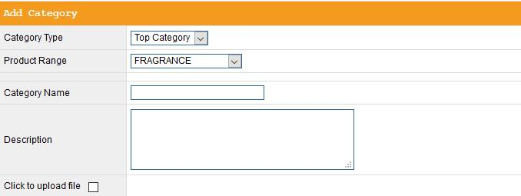
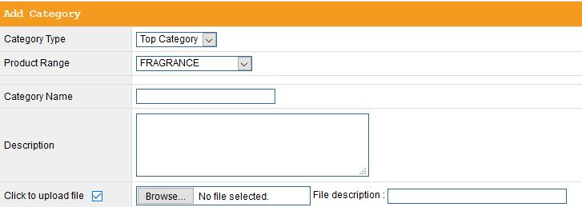
Assignment

Slide 20
FURTHER STUDIES

Slide 21
Ternary Operator
This is like a shorthand for the if..else statement.
It is an operator because it assigns values to a variable depending on a certain condition
if (condition)
result = 'something';
else
result = 'somethingelse';
result = (condition) ? 'something' : 'somethingelse';
See Example in the note
Notes:
k = 3; var x = (k<5) ? ’true’: ’false’
The value of x will be ‘true’ since the condition in the bracket is met.

